Slide 1
Registrations of SC students
Post Matric Scholarships

Slide 2
Introduction
The process of application registration is changed for SC students from academic year 2024-25.
To complete application registration involves 3 steps
a)Demo Authentication
b)Biometric Authentication
c)Complete Registration

Slide 3
Telangana Epass
The SC student should visit Telangana e-PASS website https://telanganaepass.cgg.gov.in/epassonlinelinks.do
The process mentioned in same for both Fresh and Renewal Dayscholar/CAH students.
Click on the link provided in Postmatric Fresh/Renewal Registration for SC (new)button as shown below

Slide 4
1. Demo Authentication
Demo Authentication means Matching of student name in Aadhar with name in SSC certificate.
The student enter the SSC details such as Hall ticket number ,Date of Birth , SSC pass year and pass type.

Slide 5
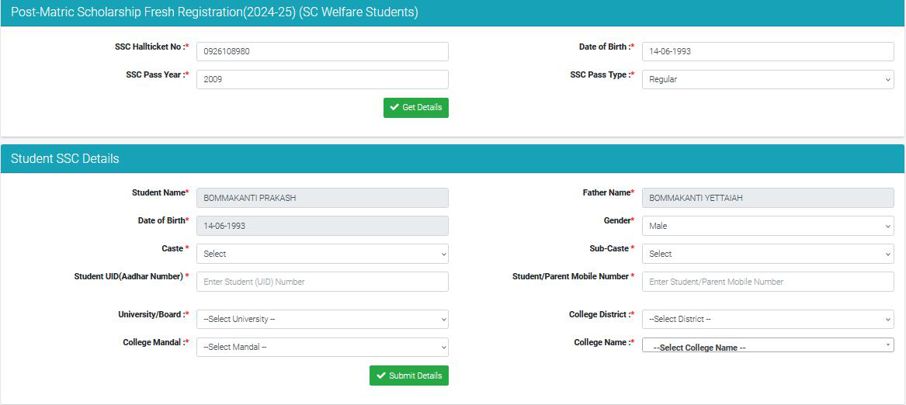
The student details will be displayed as per data available in ePASS.
Enter the details in the form Gender,Caste,Subcaste,Aadhar number,mobile number and college details
Notes:
The student details will be displayed as per data available in ePASS.
Enter the details in the form Gender,Caste,Subcaste,Aadhar number,mobile number and college details

Slide 6
For FRESH application
Demo Auth Success
Message will be displayed and details can be submitted I DEMO AUTH is success

Slide 7
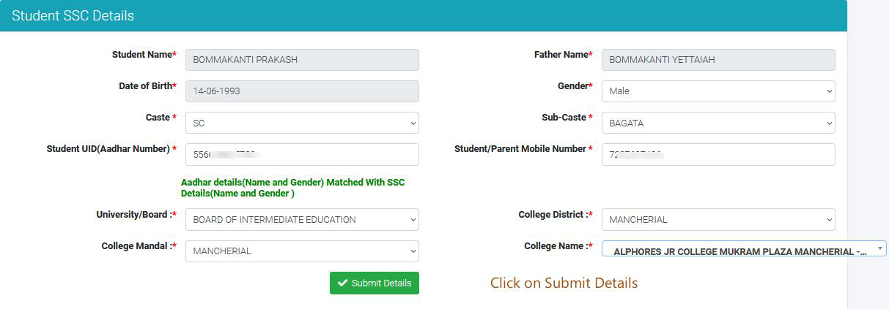
The applicant should select college details and submit application.
An application ID will be generated(only if DEMO AUTH is success) for Academic year 2024-25.This completes the 1st step in registration.

Slide 8
Telangana Epass
The application process will not be moved forward if DEMO Auth is Failed. The student need to visit Meeseva ( Aadhar )center to update name in AADHAR card as per SSC.

Slide 9
For Renewal Registration
The Student should enter the details as shown in Picture 1,then the application details will be displayed as shown in picture 2.

Slide 10
Click on Submit button
The System check with Aadhar and if name is matched it will as for confirmation to submit the application.(as shown below).Application ID will be generated.
If not matched ,the applicant shouyld visit nearest meeseva to update name in aadhar.
Notes:
Click on Submit button.
The System check with Aadhar and if name is matched it will as for confirmation to submit the application.(as shown below)
If not matched ,the applicant shouyld visit nearest meeseva to update name in aadhar.
Click on OK

Slide 11
2. Bio Metric Authentication
The Applicant need to visit nearest Meeseva to give Aadhar bio-metric/IRIS ,both fresh and renewal applicants whose DEMO AUTH is success
After Completion of Biometric/IRIS authentication student should visit ePASS website for completion of application form.
For FRESH https://telanganaepass.cgg.gov.in/FreshRegistration202425.do
For Renewal https://telanganaepass.cgg.gov.in/RenewalPrerequisite2425.do
Notes:
For FRESH https://telanganaepass.cgg.gov.in/FreshRegistration202425.do
For Renewal https://telanganaepass.cgg.gov.in/RenewalPrerequisite2425.do

Slide 12
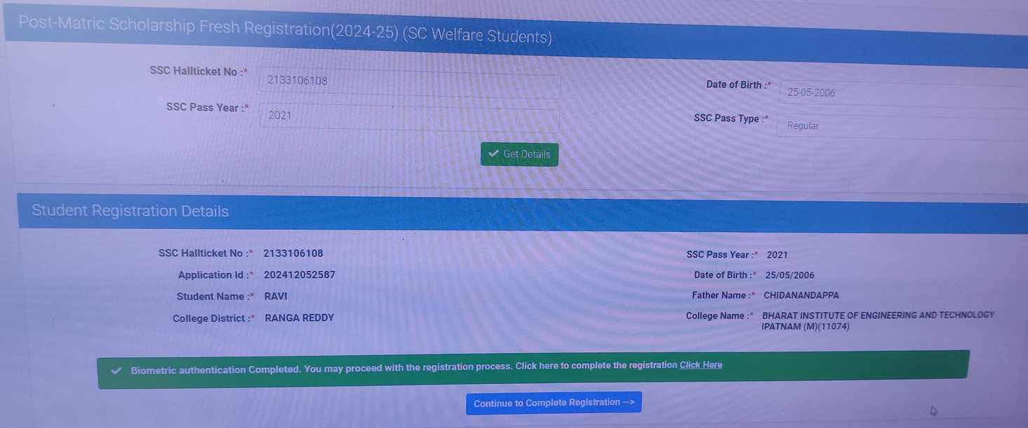
3. Completion of Application Registration
The final step is to Complete the registration form by duly filling details of applicant.
The student has to visit the Registration page i.e., FRESH/RENEWAL Registrations for SC

Slide 13
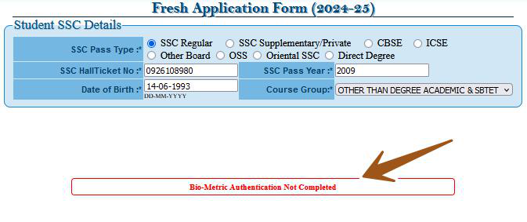
Application Form
Enter the SSC details
If Bio-metric is not done then application form will not be enabled as shown below
Notes:
Enter the SSC details
If Biomtric is not completed then application form will not be enabled.As shown below

Slide 14
The student has to fill all the details and complete the application form and submit the same at college for verification.
The Report for pendency at each level will be enabled in respective district and college logins.

Slide 15
THANK YOU

